Slide 1
Digressions on Factor Endowment Theory: Empirical Tests of the HO Theorem and Factor Content Approach
Anwesha Aditya
IIT Kharagpur

Slide 2
Testing the Pattern of Trade: Factor Content Approach
The HO model was generalized by Jaroslav Vanek (1968) into a theory
of factor content of trade known as the HOV model
The HOV model or the theory of factor content of trade provides the
theoretical basis of empirical tests of the HO theorem by Trefler (1993),
Davis and Weinstein (2001) and others

Slide 3
Factor Content and the Heckscher-Ohlin-Vanek Theorem
The HO theory was generalized by Jaroslav Vanek (1968) into a theory of factor content of trade known as the Heckscher-Ohlin-Vanek (HOV) theory.
The HOV theory or the theory of factor content of trade provides the theoretical basis of the empirical tests of the HO theorem by Leamer (1984), Brown et al (1987), Trefler (1993), Davis and Weinstein (2001) and others.

Slide 4
Higher dimensions in Trade Theory
cxnxm
Let there be c = 1, 2, …..C number of countries, and j = 1, 2, …..J number of final traded goods produced with i = 1, 2,….I number of factors of production.
Assumptions
Factors cannot move from one country to the other;
Each good is produced by the same technology in both the countries;
Production technologies for these goods differ from each other in each country;
Identical and homothetic taste

Slide 5

Jaroslav Vanek in late 1960s derive the HOV theory or factor content of trade.

Slide 6


Factor content gives how much labour is there in trade basket.
Step I. Define factor content of trade which substitutes the factor intensity assumption
Step II. Define factor abundance criteria

Slide 7

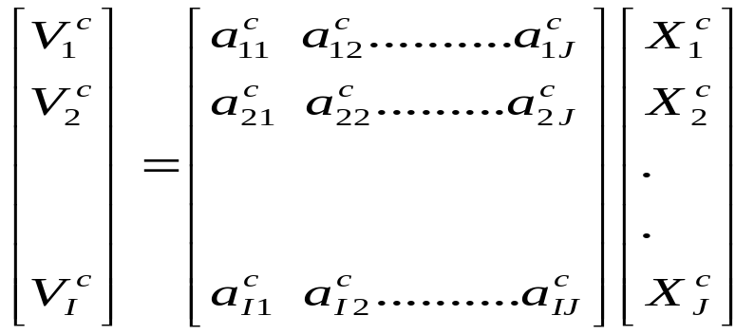
In 2 factor model, full employment condition is: L = a_{L1}X₁+ a_{L2}X₂
In this generalized set up, the full employment conditions of all factors can be written as:
⇒ V^{c} = A^{c}X^{c}

Slide 8
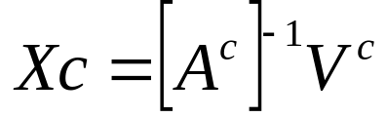

⇒

Slide 9
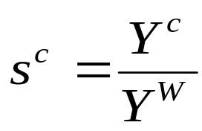

Demand side
Let preferences be homothetic and identical across countries
⇒ D^{c} = s^{c}X^{W}
Demand vector is proportional to world output vector
where s^{c} is the country-c’s share of world income
Now world GDP:

Slide 10
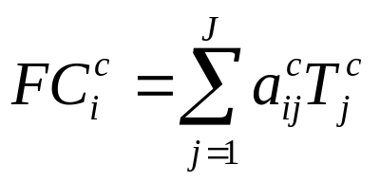
Factor Content
Content of each factor-i in the vector of good j is the corresponding
element of the vector FC^{c}
FC^{c} = A^{c}T^{c} = A^{c}X^{c} - A^{c}D^{c}
Factor content of trade is a measure of how much of a factor is
embodied in a traded good
T_{j} = X_{j} - D_{j}
The measured content of factor i in trade FC_{i}^{c} is > 0 or < 0 if it is more intensively used in exports or in imports since by definition Tj > 0 if j is exported

Slide 11
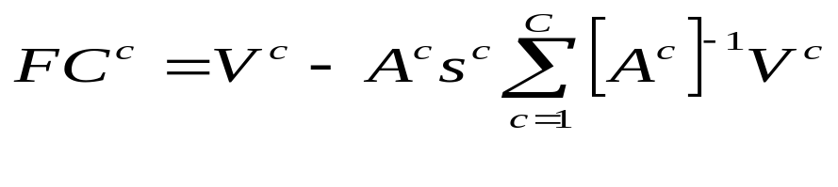

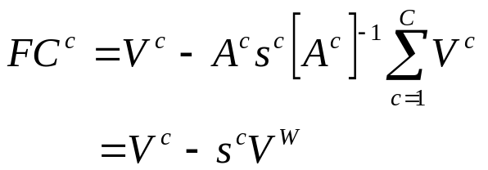
Content of each factor-i in the vector of good j is the corresponding
element of the vector FC^{c}
FC^{c} = A^{c}T^{c} = A^{c}X^{c} - A^{c}D^{c}

Slide 12
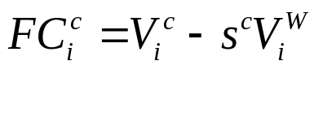
A typical element is,
which is a number that measures the “net” content of factor i in all goods
traded by country-c.
The factor content equation
This number measures the ‘net’ content of factor-i in all goods traded by country-c

Slide 13
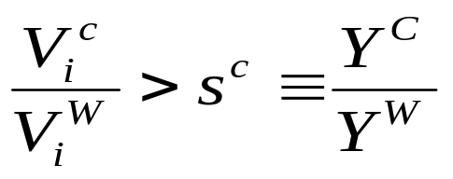
If country-c is abundant in factor-i in the sense that it has a larger share of world stock of factor-i than its income share.
Factor-i would tend to be used more intensively in exports than in imports
⇒ A labour abundant country implicitly exports labour
This is the Factor Content Approach or HOV Theorem

Slide 14
Evidence from the Literature using HOV theorem
Leamer (1984) re-specified Leontief’s test and found support for the HOV theorem using the HOV theorem and the factor content approach.
Brown et al (1987) restimated endowments of 12 factors of production for 27 countries and found that the United States is not very capital abundant.

